Slide 1
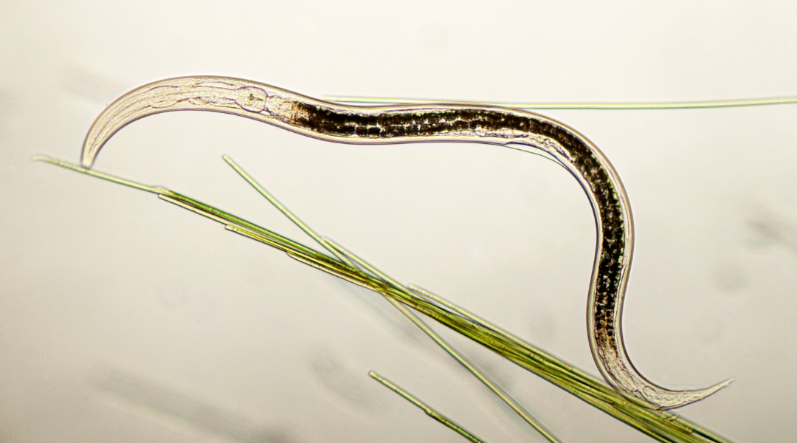
Lab 2:
Pipette Workshop and Introduction to Nematodes
Notes:
Turn on water baths

Slide 2
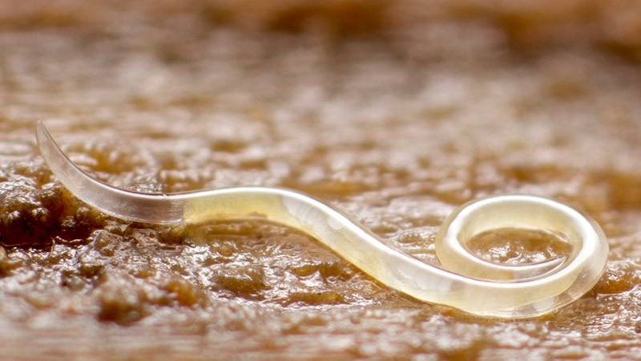
Housekeeping
Due Today:
Lab 2 pre-lab
Coming up:
Individual Figure Facts
Lab 3 pre-lab
Collect a gastropod (1 per group)
Skills Demonstration Sign-Up

Slide 3
Group Norm Activity
Consider your responses to the group norm activity from the Start Here module. Discuss your thoughts and responses with your group mates.
Each of you should complete the group contract sheet and refer back to it as needed throughout the term. We encourage you to exchange contact information (university email, cell phone numbers etc…)

Slide 4
Due Next Week: Pre-Lab Individual Experimental Design Outline
Carefully read the Term Project Overview in your lab manual
Download the Experimental Design Outline template from the assignemnt on Canvas
Identify your study variables and anticipated results
Develop a Question, Hypothesis and Prediction that align with the project goals
*While we typically follow the 30% TurnItIn score cut-off, the similarity % for this assignment will be very high and that is OK!
Notes:
Outline the assignment that’s due next week, and let them know the similarity score will be high for this one. We still want them to use the template, though.

Slide 5
Due Next Week: Individual Figure Facts Assignment
Download paper and assignment template from Canvas
Read the paper, fill out template digitally, and submit to Canvas
You may chat with other students about it, but you must each write your own summary.*
*While we typically follow the 30% TurnItIn score cut-off, the similarity % for this assignment will be very high and that is OK!
Use of generative AI tools such as ChatGPT is restricted to the following uses: We expect you to read this article to practice scientific reading. However, we know that scientific reading is challenging. You can use AI to provide an overview of the article at an appropriate reading level. If you use AI, you must cite it. You may not use AI to generate assignment answers. Ask your instructor/TA if you have any questions about this policy.
Notes:
Outline the assignment that’s due next week, and let them know the similarity score will be high for this one. We still want them to use the template, though.

Slide 6
Lab 2 Outline
Activity | Time
Lab introduction and logistics | 20 min
Part 1: Surveying Gastropods | 30 min
Part 2: Pipetting Practice | 35 min
Part 3: Experimental Studies with Nematodes | 60 min
Part 4: Group Experimental Design | 35 min

Slide 7
Lab 2 Objectives:
Demonstrate knowledge of proper pipette use.
Demonstrate the knowledge of an experimental setup.
Plan and design a nematode experiment.
Use microscope skills from Lab 1 to observe nematodes in a sample.
Apply the scientific method to investigate a biological question

Slide 8
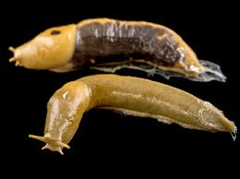
Part 1: Introduction to Surveying Gastropods
Gastropods are a diverse class (60,000 known species) of mollusks that include snails, slugs and limpets.
Found in various environments including terrestrial, freshwater, and marine habitats.
Ecological role: herbivores, detritovores, and prey for other animals.

Slide 9
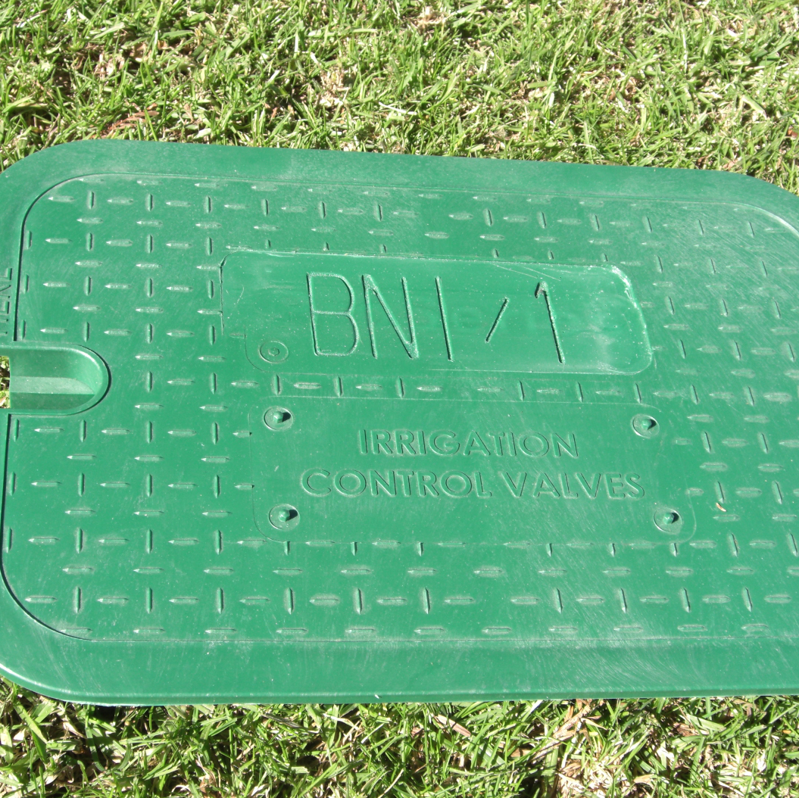
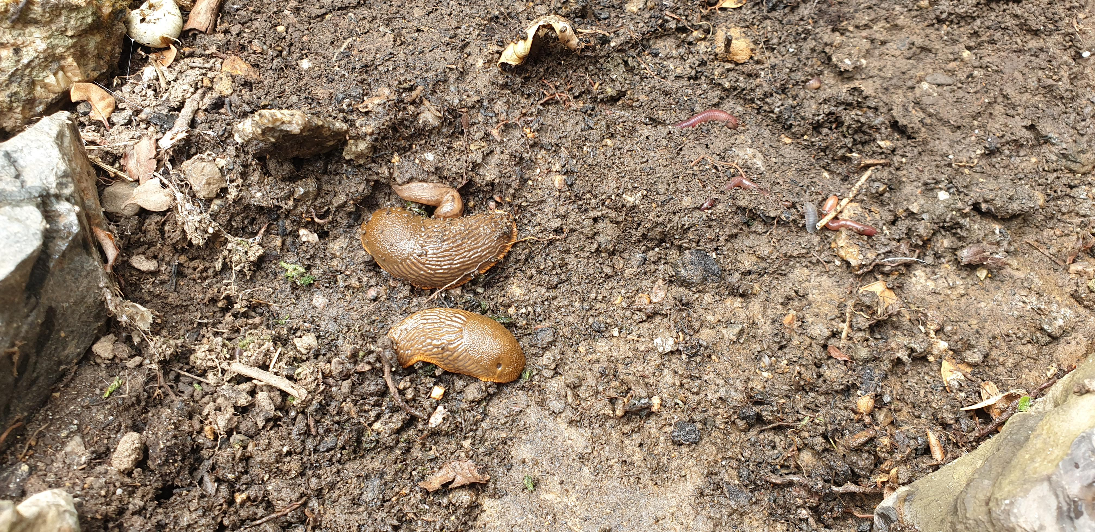
Part 1: Introduction to Surveying Gastropods
For your term project, you will be conducting a survey of nematodes associated with local terrestrial gastropods (land-dwelling slugs and snails)
Today we will show you how to find them and collect them
To find snails/slugs you may need to turn over rocks, logs, or tree bark or lift up irrigation box lids

Slide 10
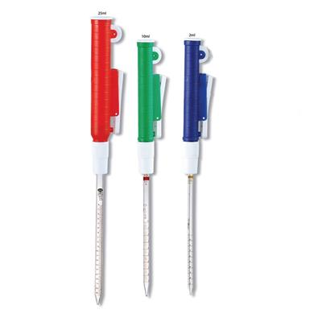
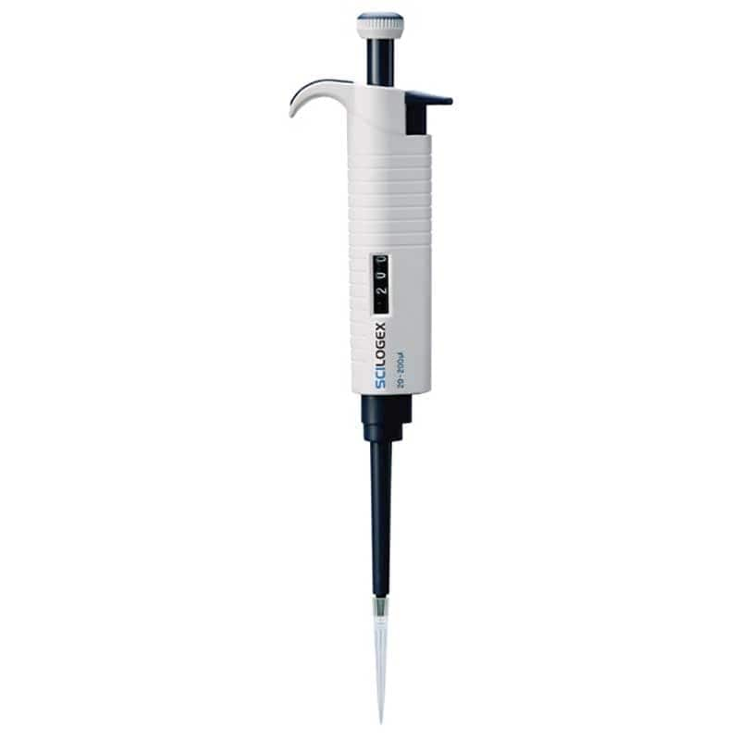
Part 2: Pipetting Practice
Skills Demo
Practice using each pipette
Complete the comparison table at the end of part 1
Serological pipette
Transfer (1mL) pipette
Micropipette

Slide 11
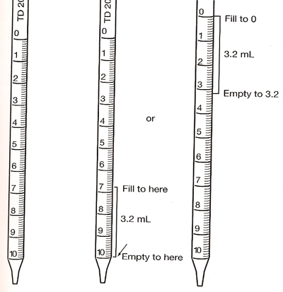
Tips for Part 1
0 mL
and return remaining solution to container
10 -3.2 = 6.8
Serological pipette tip numbers are reversed
Max mL

Slide 12
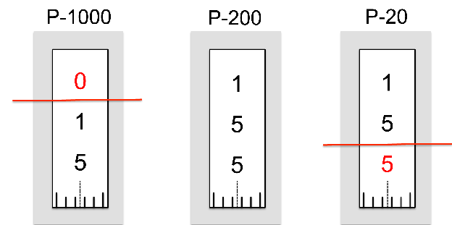
Tips for Part 1
Never use the micropipette without a pipette tip
Never lay the pipette down while it has liquid in the tip
Draw liquid up slowly and dispense carefully
Practice without liquid first
0150 µl
(0.15 ml)
155 µl
15.5 µl

Slide 13
Tips for Part 1
Never use the micropipette without a pipette tip
Never lay the pipette down while it has liquid in the tip
Draw liquid up slowly and dispense carefully
Practice without liquid first
0155 µl
155.5 µl
15.55 µl
ESTIMATE LAST DIGIT

Slide 14
Your turn!
Push down until first stop
Draw up fluid
Dispense down to second stop.
Always dispense and draw slowly.

Slide 15
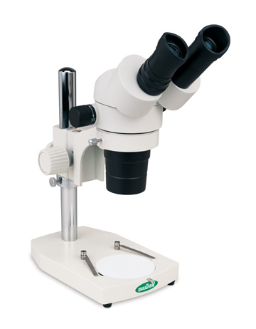
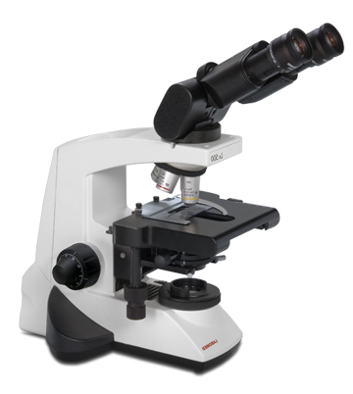
Part 3: Intro to nematodes
Observe and draw two different nematodes using the dissecting microscope
Observe one type of nematode using the compound microscope

Slide 16
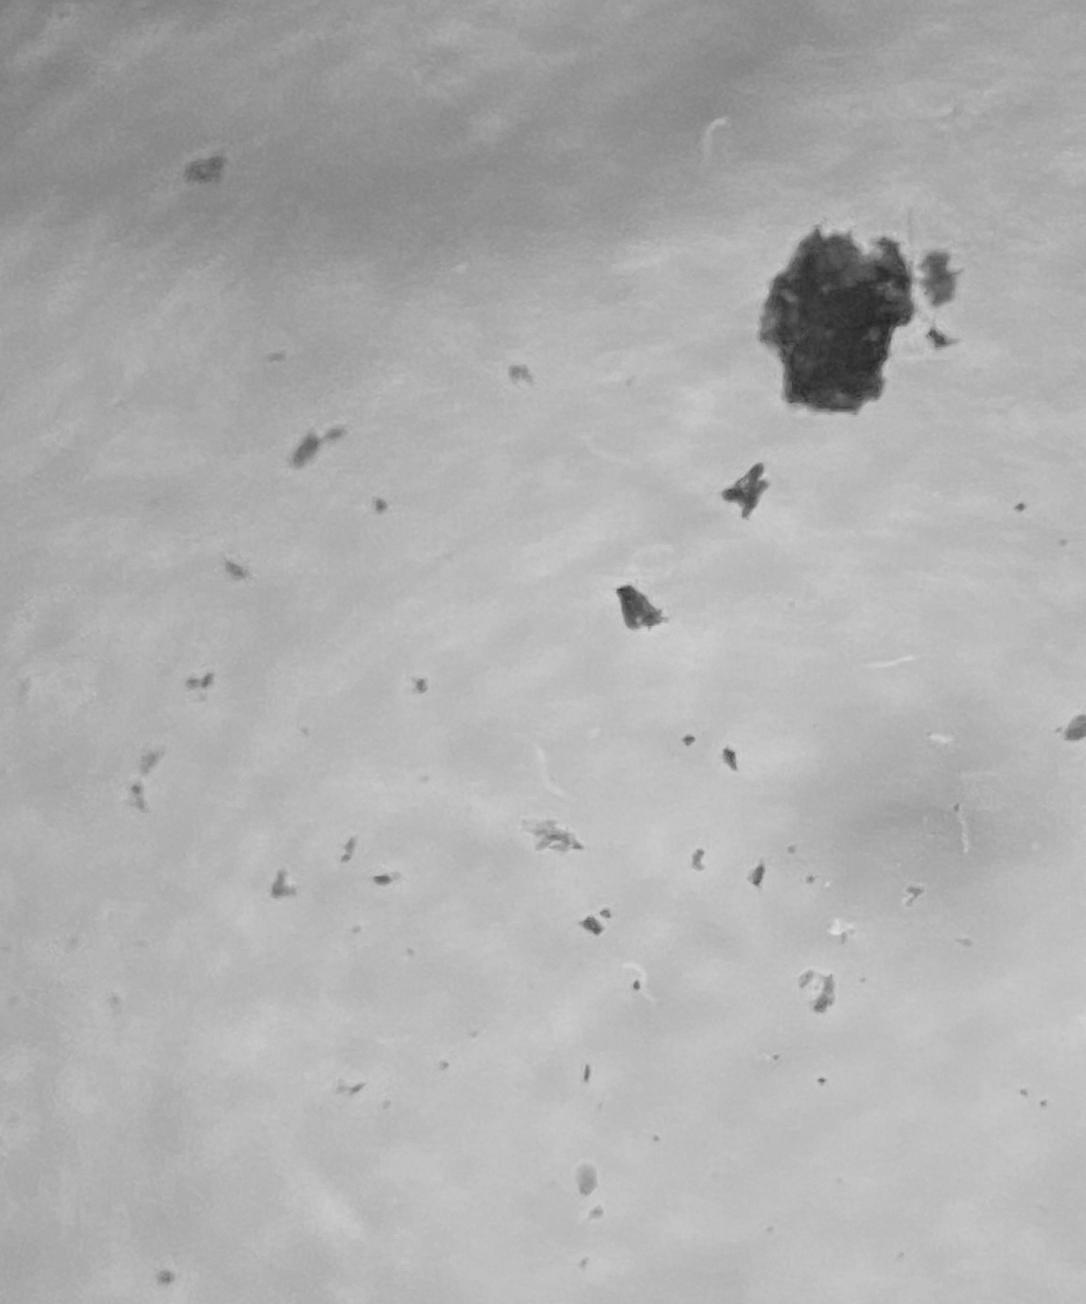
Part 3: Intro to nematodes
Note:
Many things under the microscope may look like nematodes but are in fact not. A good rule of thumb is that if it is not moving, it is likely not a nematode. This will be the criteria you will use when finding nematodes in the samples you collect.
Observe and draw two different nematodes using the dissecting microscope
Observe one type of nematode using the compound microscope
nematodes
Notes:
Reminder that nematodes are quite small under the dissecting scope

Slide 17
Part 4: Group Experimental Design
Refer back to the term project overview in your lab manual
Write a scientific question you and your group might explore
What is the rationale for your question (i.e., why do we care?)
Write a hypothesis (what makes a good hypothesis?)
Write a prediction (what makes a good prediction?)

Slide 18
Clean Up
Return nematode samples to where you go them (make sure they are closed so they don't dry up)
Dispose of coverslips in glass disposal box
Clean glass slides and return to tray
Return everything and straighten tray on lab table
Adjust microscopes to low power, turn off, and cover properly
Wash hands

Slide 19
Reminders for Next Week
Lab 3 pre-lab (do this early, it takes time!)
Figure Facts Assignment (do this early, it takes time!)
Collect a gastropod (at least 24 hours before lab)
Take a collection container with you today
Once collected, dampen the paper towel and keep it moist
Secure the lid

